Slide 1
Adham Ashraf Saeed
Assignment 2 (Power BI)

Slide 2
Load the provided dataset
Data Source

Slide 3
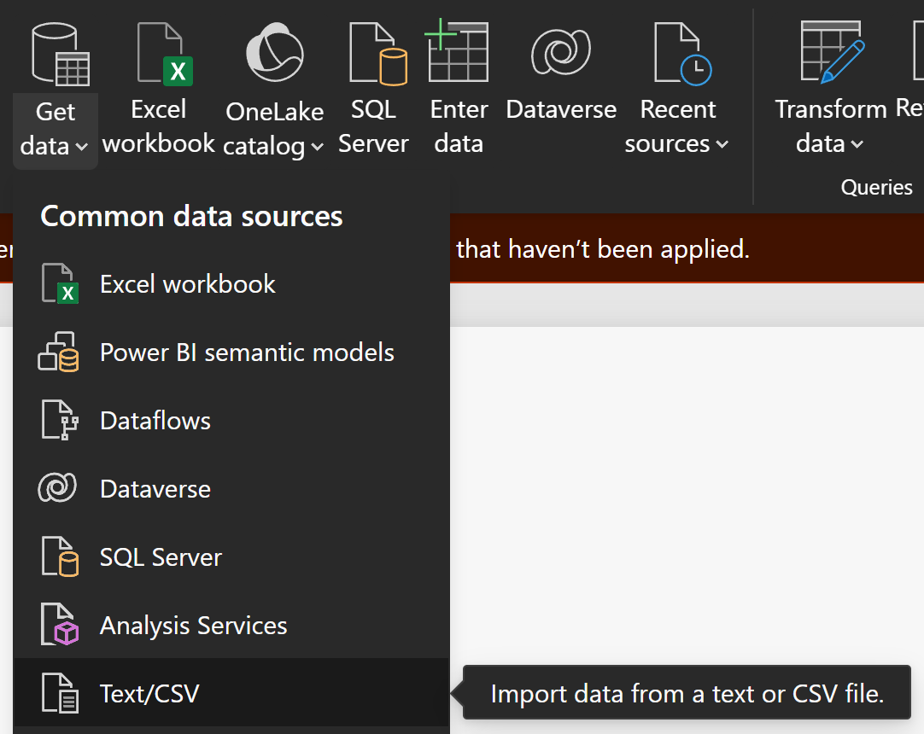
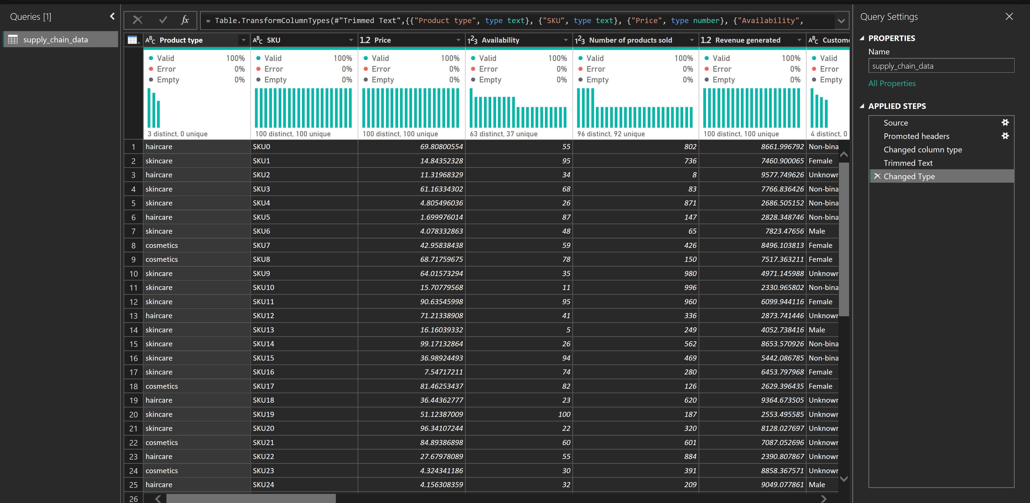
Import Data

Slide 4
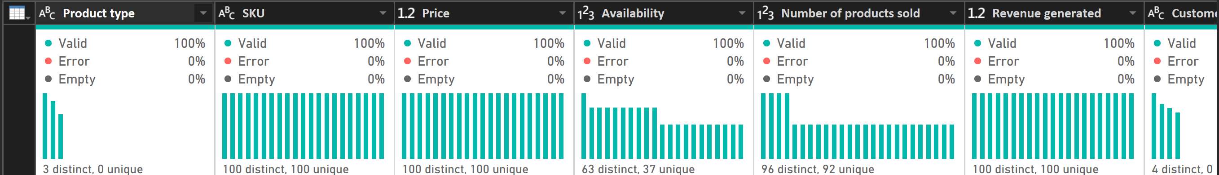
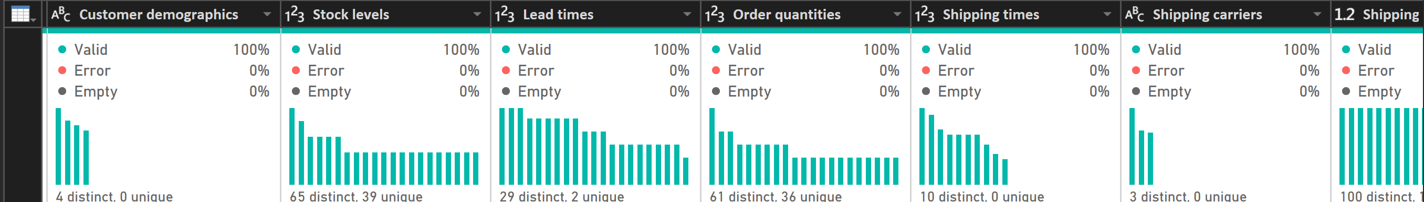
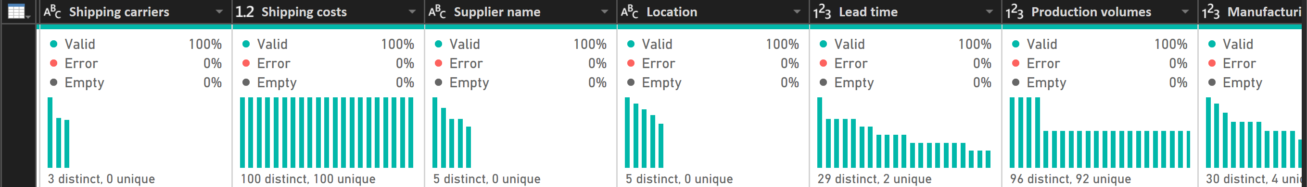
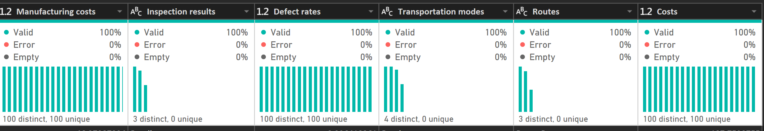
Clean Data

Slide 5
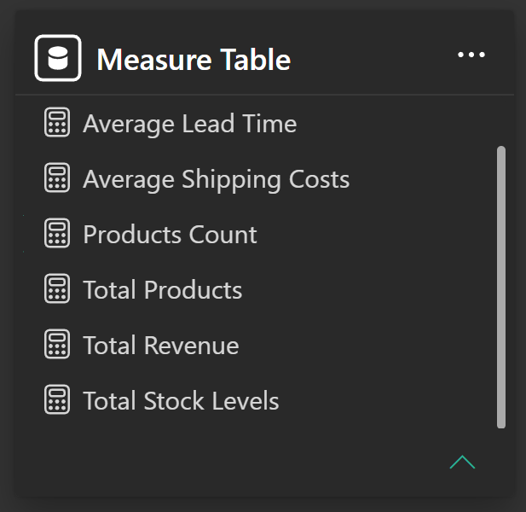
Create Measures

Slide 6
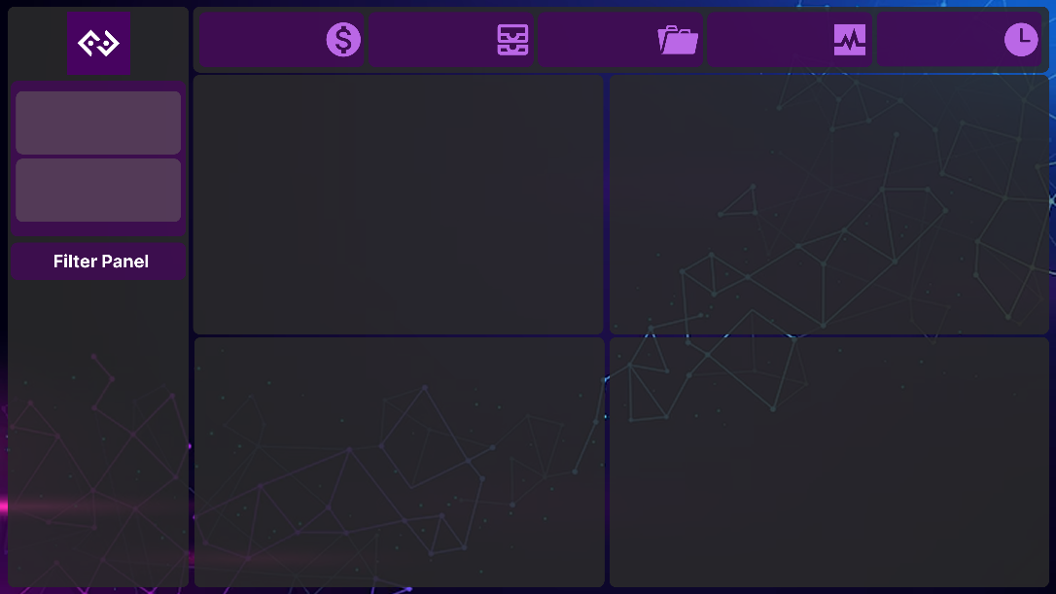
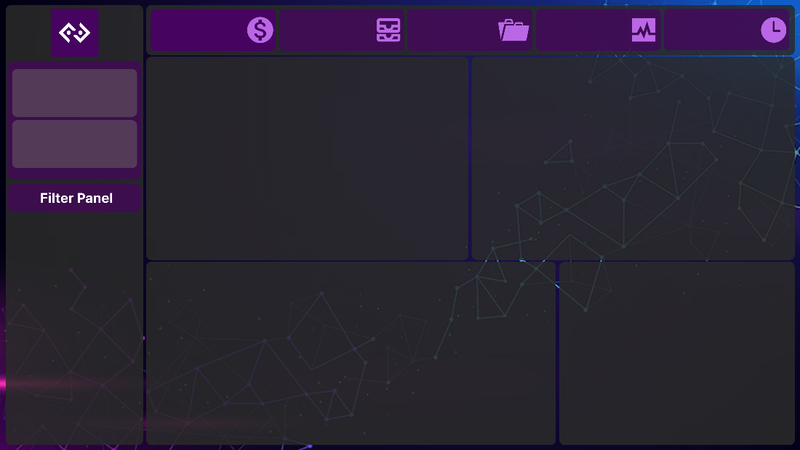

Figma Design Dashboard

Slide 7
Key Performance Indicators (KPIs)
Total Revenue Generated
Total Products Sold
Total Stocks
Average Shipping Costs
Average Lead Time

Slide 8
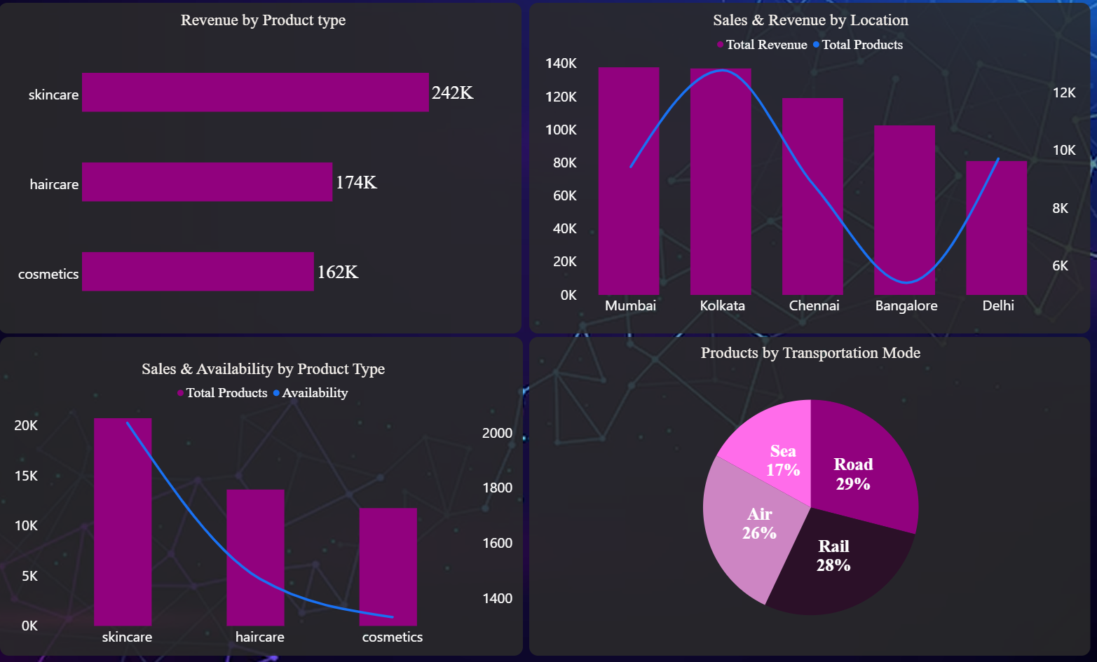
Charts
A bar chart showing the distribution of products sold and availability
Another bar chart illustrating products sold and revenue generated by location
A pie chart mapping products by transportation mode
A bar chart for revenue generated by product type

Slide 9
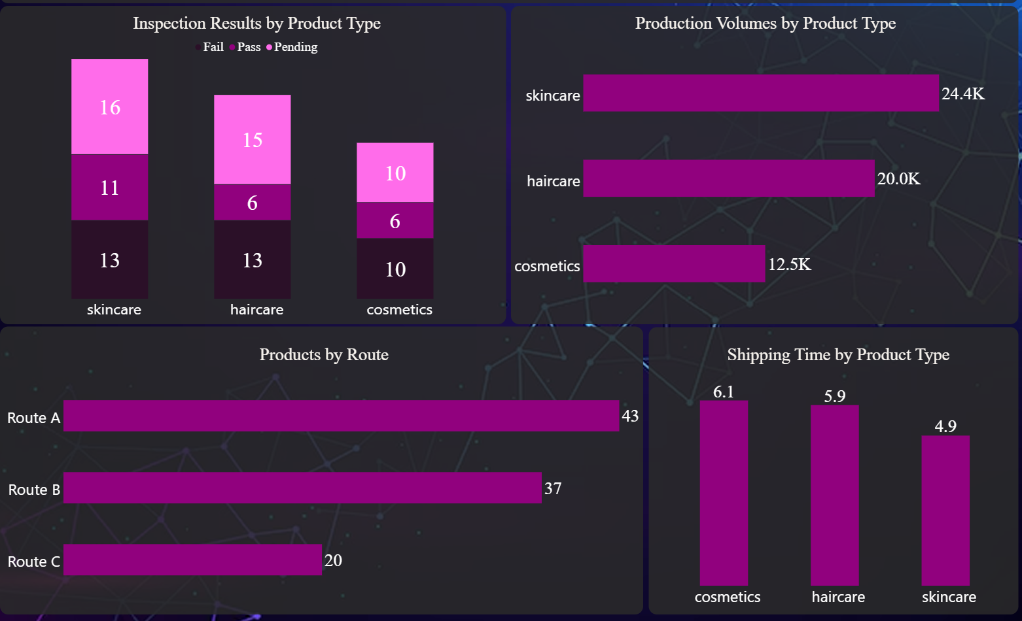
Charts
Another bar chart showing product type by inspection result
A bar chart displaying shipping times by product type
A bar chart for production volumes by product type
And finally, a bar chart illustrating products by routes

Slide 10
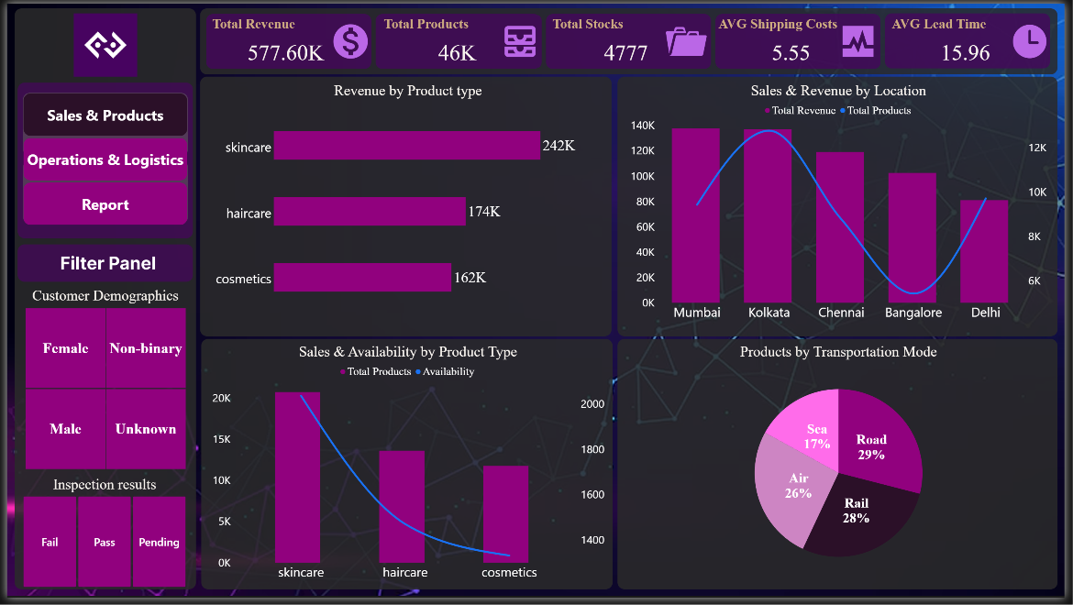
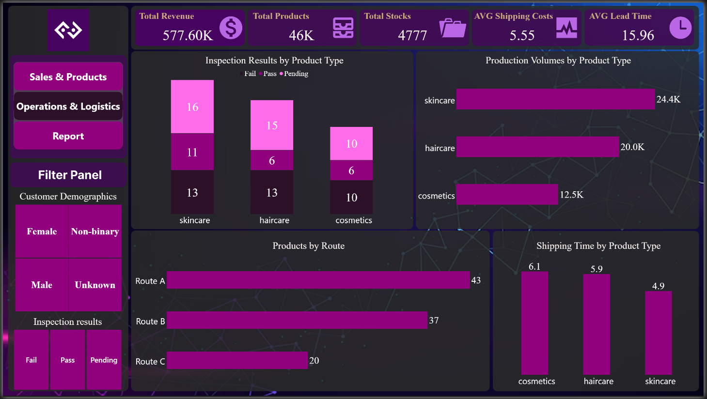
Final Dashboard

Slide 11
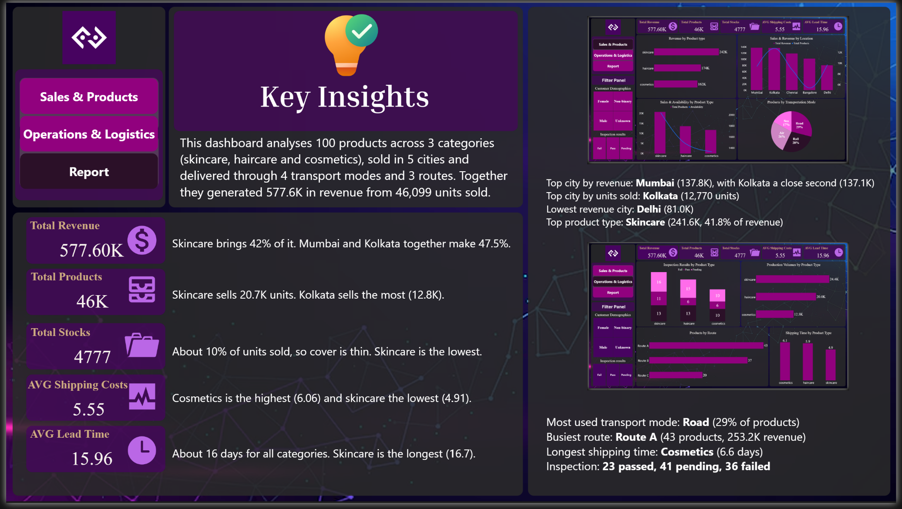
Report

